Slide 1

Basic Details of the Team and Problem Statement
Ministry/Organization Name/Student Innovation:
Indian Space Research Organisation
PS Code: SIH1524 [Software]
Problem Statement Title:
Domain Name Server (DNS) Filtering Service using Threat Intelligence feeds and AI/ML Techniques
Team Name: NetOptiq
Team Leader Name: Issac Gladin S
Institute Code (AISHE): U-0460
Institute Name: Karunya Institute of Technology and Sciences
Theme Name: Space Technology

Slide 2
Idea/Approach Details
Technology Stack
Enterprise Architecture hosted on a Cloud with Kubernetes Cluster of multiple AI Powered, Load Balanced, DNS Servers with DNS over UDP/DTLS/HTTPS support and high performance DNS Cache, that filter malicious DNS Domains based on the domain categories maintained in a Distributed Blacklist Database which is shared between the servers and dynamically updated using an AI Engine, with malicious query filtering support and a performance monitoring Dashboard.
User Dashboard:
Front-End: React.js
Back-End: Django (DRF)
Cache Server: Nginx
DNS Server: Unbound
Log: Fluentd, MongoDB
Threat Intelligence: MISP, CIRCL OSINT
Monitoring: Prometheus, ELK
IDEA
High-Performance DNS Resolution
Stateless Servers: requests without relying on any local session or state data, making them more resilient and scalable.
In-memory Caching: DNS queries in memory for rapid response times.
Dynamic Blocking Mechanism
Real-time Threat Intelligence Integration: Continuously update the blacklist.
Machine Learning Models: Train AI models to identify new malicious domains or false positives.
Flexible Policy Management: Customize blacklist, whitelist, and content filtering policies.
Security Enhancements
Containerization: Kubernetes for containerizing the DNS service.
User Interface
Web Dashboard: A web-based dashboard with analytics for admin to manage their settings, view statistics, and generate reports.
AI Engine:
Malicious, Phishing Domain Classification:
Ensemble Model with SVM and XGBoost (Accuracy: 97.7%)
DGA Domain Identification:
LSTM and Transformer (DistilBERT)
(Accuracy: 98.1%)
UNIQUE FEATURES
Data Sources:
Malware and Phishing:
Phishtank
Phishstorm
Shallalist
DGA Datasets:
DGA-botnet Dataset
URL-ISCX Dataset
DNS Blacklists:
DNSBL
CIC-Bell-DNS
Zero Trust DNS - Rigorous DNS request validation
Smart Caching - High Performance, reduced latency
Adaptive Threat Intelligence - AI/ML-driven threat adaptation
Real-time Phishing and Anomaly Detection - Instant threat identification and response
Customizable Threat Response - Tailored security responses for domains
Interactive Threat Visualization Dashboard - User-friendly threat data exploration
NOVELTY

Slide 3
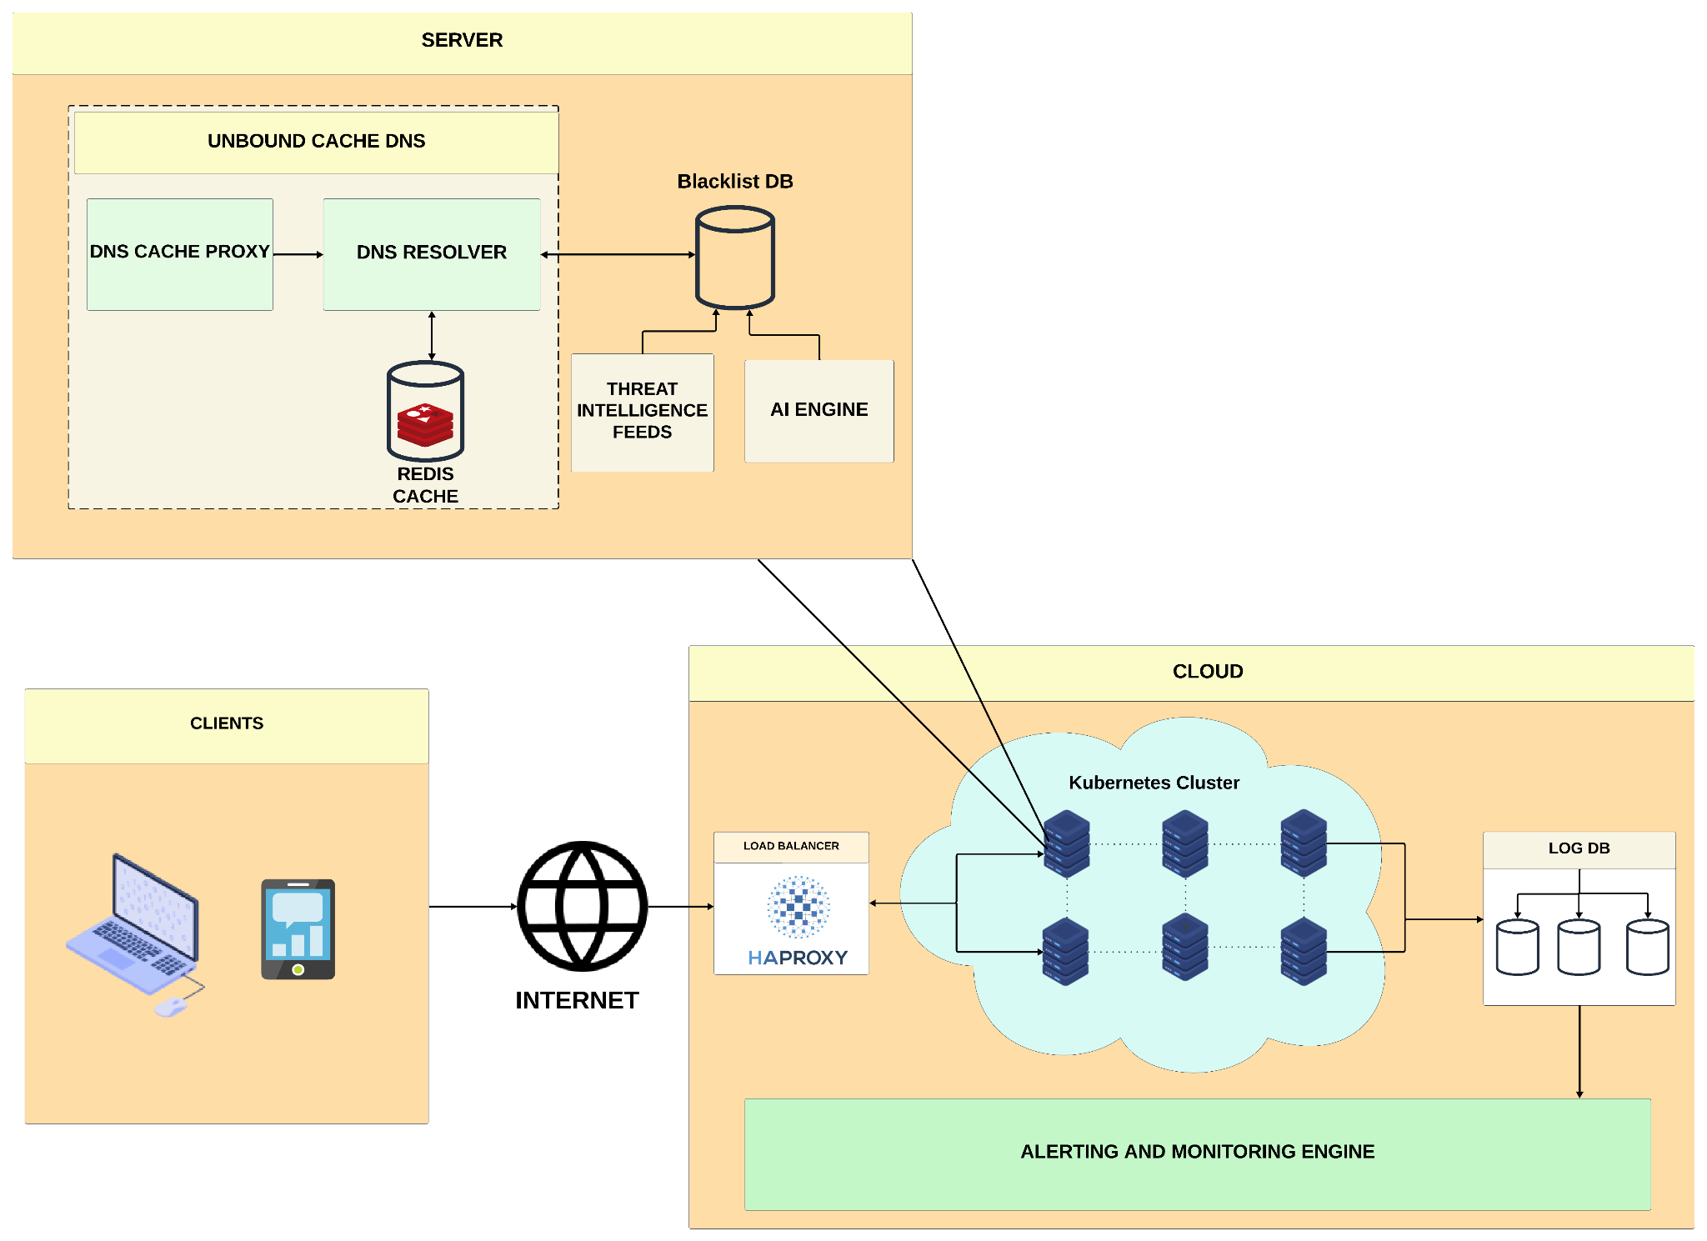
System Architecture
DNS Cache Proxy Servers - Nginx DNS Proxy which caches DNS requests and proxy DNS requests to multiple DNS Resolver servers. These servers will also serve the “Domain Blocked” page.
DNS Resolver Servers - Unbound DNS Caching servers which serves the benign DNS requests from Redis Cache and redirects malicious domain requests found in Blacklist database to a block page.
Blacklist Database - CockroachDB distributed database which maintains domain categories: malware, phishing, adware, botnet (DGA) domains etc. and updated by the AI Engine.
AI Engine - Machine Learning multi-class classification and Deep Learning Algorithms to classify the domains trained on the datasets updating the database on a real-time basis.
Threat Intelligence Engine - Identifies threats from feeds such as MISP, AbuseIPDB, CIRCL OSINT
Load Balancer - HAProxy which load balances incoming DNS Traffic to multiple servers.
DNS Cache Proxy Servers - Nginx DNS Proxy which caches DNS requests and proxy DNS requests to multiple DNS Resolver servers. These servers will also serve the “Domain Blocked” page.
Log Database - MongoDB database to stores logs from all servers.
Monitoring Engine - Monitors the logs, traffic, detects anomaly and generates alerts.

Slide 4
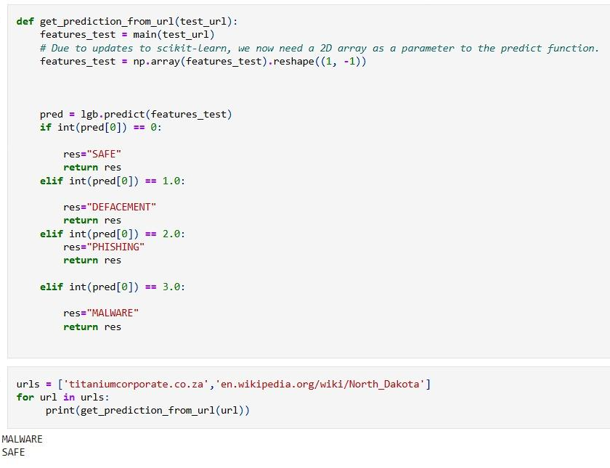
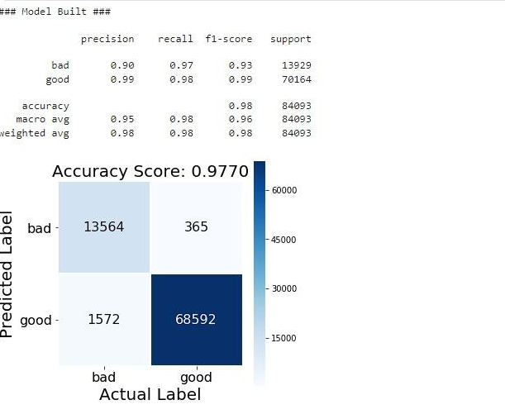
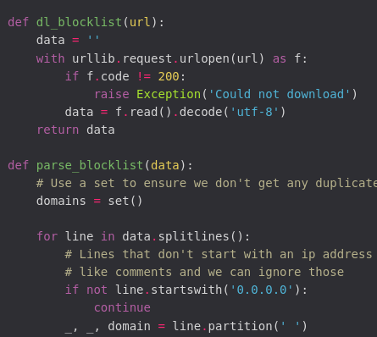
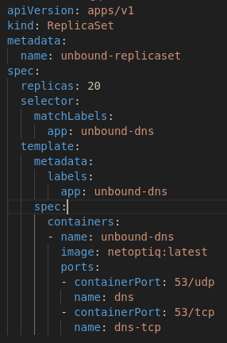
Use Cases
Output Results
Testing of ml model
Training of ml model
Comprehensive Internet Access Protection: Our solution ensures the safeguarding of internet access, extending its coverage to all network devices, office locations, and roaming users.
Robust DNS Activity Logging: We maintain detailed logs of DNS activity, categorizing it based on security threats or web content types and recording the corresponding actions taken, whether it was allowed or blocked.
Long-Term Data Retention: Our system securely retains activity logs for 30 days, with the option for export to enable longer retention, facilitating in-depth investigations when necessary.
Rapid Deployment: Implemented swiftly, our solution efficiently covers a multitude of locations and users within minutes, ensuring an immediate return on investment.
Comprehensive Reporting: Our reporting capabilities are extensive, providing detailed insights into internet activity, including full URL addresses, network identity, actions taken (allow or block), and external IP addresses.
Policy Enforcement and Compliance: We offer content filtering by category or specific URLs to enforce policies and compliance regulations, blocking destinations that violate established guidelines.
Script for Updating Blacklists
Kubernetes Configuration
Show Stopper
False positives: To minimize wrong classifications, regular updates and improvements to the models are necessary, along with a feedback system that allows users to report misclassifications.

Slide 5
Team Member Details
Team Leader Name: Issac Gladin S
Branch : B.Tech. Stream : CSE Year : IV
Team Member 1 Name: Gifton Paul Immanuel
Branch : B.Tech. Stream : CSE Year : III
Team Member 2 Name: Bewin Felix
Branch : B.Tech. Stream : CSE Year : III
Team Member 3 Name: Shirlyn Jenita J
Branch : B.Sc. Stream : CS Year : III
Team Member 4 Name: Allen Matthew
Branch : B.Tech. Stream : CSE Year : II
Team Member 5 Name: Jerin Stalin
Branch : B.Tech. Stream : CSE Year : I
Team Mentor 1 Name: Prof. S E Vinodh Ewards
Category : Industry Expertise: AI / ML / Cyber Security / Networking Domain Experience: 19 years

